Slide 1
Unix / Linux Fundamentals for Beginners

Slide 2
Unix/ Linux Overview
I

Slide 3
Objectives of this Session
Understand the origins of Unix and Linux
Understand OS Fundament
Know the differences between Flavors and Distributions
Know how to Logging in and out of a Unix system
Understanding Basic Command structure and syntax
Know where to find help

Slide 4
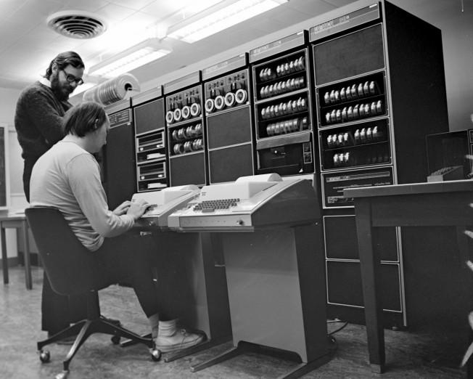
Ken (seated) and Dennis (standing) at a PDP-11 in 1972.

Slide 5
Origins of Unix and Linux
Unix was born in 1969 out of the mind of a computer scientist at Bell Laboratories, Ken Thompson for a PDP-7 minicomputer along with Dennis Ritchie, the co-inventor of Unix and the inventor of the C language
The original spelling was “UNICS” (UNiplexed Information and Computing Service), described as “a pun on Multics”, which stood for MULTiplexed Information and Computing Service
In 1977, Berkeley campus of the University of California made the first BSD release
Ideas and code from Berkeley Unix (including the vi(1) editor) were feeding back from Berkeley to Bell Labs
The first Unix company (the Santa Cruz Operation, SCO) began operations in 1978, and the first commercial C compiler (Whitesmiths) sold that same year
1982 launching of Sun Microsystems, by founders Bill Joy, Andreas Bechtolsheim, and Vinod Khosla set out to build a dream Unix machine with built-in networking capability. They combined hardware designed at Stanford with the Unix developed at Berkeley to produce a smashing success, and founded the workstation industry
By 1983 there were no fewer than six Unix-workalike operating systems for the IBM-PC: uNETix, Venix, Coherent, QNX, Idris, and the port hosted on the Sritek PC daughtercard

Slide 6
Origins of Unix and Linux
In 1985 Intel shipped the first 386 chip, capable of addressing 4 gigabytes of memory with a flat address space. This was big news, because it meant that for the first time, a microprocessor in the dominant Intel family had the capability to run Unix without painful compromises.
Serious standardization efforts aimed at reconciling the System V and Berkeley APIs also began in 1983 with the /usr/group standard. This was followed in 1985 by the POSIX standards, an effort backed by the IEEE. These described the intersection set of the BSD and SVR3 (System V Release 3) calls, with the superior Berkeley signal handling and job control but with SVR3 terminal control. All later Unix standards would incorporate POSIX at their core, and later Unixes would adhere to it closely
The first glimmer of light in the darkness was the 1990 effort by William Jolitz to port BSD onto a 386 box,. The 386BSD port was possible because, partly influenced by Stallman, Berkeley hacker Keith Bostic had begun an effort to clean AT&T proprietary code out of the BSD sources in 1988
In August 1991 Linus Torvalds, then an university student from Finland, announced the Linux project. Torvalds is on record that one of his main motivations was the high cost of Sun's Unix at his university. Torvalds has also said that he would have joined the BSD effort had he known of it, rather than founding his own. But 386BSD was not shipped until early 1992, some months after the first Linux release

Slide 7
Understand OS Fundamentals
Process Management
  The OS is in charge of creating and destroying processes and handling their connection to the outside world (input and output).
  In addition, the scheduler, which controls how processes share the CPU, creating an illusion of several processes running on top of a single CPU is part of process management
Memory Management
  The computer’s memory is a major resource, the OS builds up a virtual addressing space for any and all processes on top of the limited available resource
Filesystems
  To OS provides structured filesystem on top of unstructured hardware, and the resulting file abstraction is heavily used
Device control
  Almost every system operation eventually maps to a physical device. With the exception of the processor, memory, and a very few other entities, any and all device control operations are performed by the OS that is specific to the device being addressed
Networking
  Is managed by the operating system. Incoming packets are asynchronous events, which are collected, identified, and dispatched before a process takes care of them

Slide 8





Flavors and Distribution
System V
BSD Unix FreeBSD
Solaris Digital Unix
IRIX AIX
Linux - distro
  RedHat Slakeware Mandrake Ubuntu
  Debian SuSE Knoppix Fedora

Slide 9
Logging In / Logging Out
Users must always be authenticated to use system resources on UNIX
There are two modes of logging in CUI or GUI
console, is fast and humble on resources (dumb terminals)
X, is slow and hard on resource requirements
#(root) and $(user id) , Super user and normal user
suid /sgid programs, eg: ftp, passwd
Logging out with exit or ctrl+d
Shutting down the system – shutdown –h now
Getty is the program that enables you to log in through a serial device such as a virtual terminal, a text terminal, or a modem
Once you enter your username, getty hands this over to login which asks for a password, checks it out and gives you a shell
Gettys are usually started in /etc/inittab. Login checks user details in /etc/passwd, and if you have password shadowing, /etc/shadow

Slide 10
Basic Command structure and syntax
$command <options> <ctrl+m>
Eg:
  ls –la <ctrl+m>
    Command:
      ls
    Options:
      l - list file details
      a – list all files including hidden ones

Slide 11
Help .. !!!
help <command>
man <command>
info <command>
aprops <command>
/usr/doc
How-To documents @ http://www.linuxdoc.org
F1 context sensitive help in X
Other resources on the net
  www.google.com/linux
  www.google.com/bsd
  Forums and #IRC chanels

Slide 12
System Architecture
II

Slide 13
Objectives of this Session
Basic Architecture of an Unix system
Understand how Unix manages a Process
Understand the File system structure
Understand how Unix handles file permissions
Know how to customize the Unix environment

Slide 14
Unix Architecture
Shell
Kernel
HW

Slide 15
Process
Process carry out tasks within an operating system, a process can be thought of as a computer program in action
Unix is a multiprocessing OS, many processes seem to run simultaneously
Processes are maintained in a struct called task_struct
Maximum number of process that can run in a system defaults to 512, size of the task vector
The task_struct holds info such as
  State: Runing, Waiting, Stopped, Zombi
  Scheduling info: Which process is most in need to run
  Identifier: Every running process is uniquely identified, with its PID
  Links: Every process except the init process, has a parent process
  Processes are held in doubly inked list to whose rot is init processes task_struct data structure. This is required to support commands like ps and kill
  Filesystem: Process can open files on the filesystem, all open files for a process are held in file descriptors
Process can run is two modes User mode or Kernel mode
User mode processes have lesser privileges than kernel mode

Slide 16
Process
A process switches from user mode to kernel mode when it makes a system call
init program is the first program to run after the kernel begins running
The init, does some initial setting up of the system (mounting root “/” file system), and runs the initialization scripts available in /etc/inittab , /bin/init, or /sbin/init
Creating new processes, these new processes may themselves go on creating new processes
Eg:getty-> login -> shell
<command> &, puts the process in the background
jobs, shows the process running in the background
Ctrl+z, Suspend (stop, but not quit) a process running in the foreground (suspend)
Ctrl+c, Interrupt (terminate and quit) a process running in the foreground
bg, reactivate suspended program in the background
fg, puts the job back in the foreground
kill, End a process

Slide 17
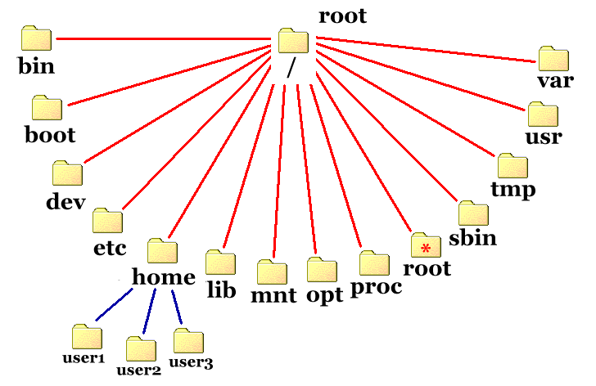
Filesystem

Slide 18
Filesystem
A filesystem is the methods and data structures that an operating system uses to keep track of files on a disk or partition; that is, the way the files are organized on the disk
/ - The root directory is considered to be the top of the whole filesystem both in Linux and UNIX
/bin - The bin directory contains several useful commands that are of use to both the system administrator as well as non-privileged users
/boot - This directory contains everything required for the boot process except for configuration files not needed at boot time (the most notable of those being those that belong to the GRUB boot-loader) and the map installer
/dev - The location of special or device files, such as cdrom, had, scd, ttyS0
/etc - This is the nerve center of your system, it contains all system related configuration files in here or in its sub-directories
/home - Linux is a multi-user environment so each user is also assigned a specific directory that is accessible only to them and the system administrator
/lib - This directory contains kernel modules and those shared library images (the C programming code library) needed to boot the system and run the commands in the root filesystem, ie. by binaries in /bin and /sbin. Libraries are readily identifiable through their filename extension of *.so

Slide 19
Filesystem
/media – This directory holds mount points to cdrom, dvd etc
/mnt – This directory traditionally used to hold the mount points, but is now used to hold temporary mount points
/opt - This directory is reserved for all the software and add-on packages that are not part of the default installation. For example, StarOffice, Kylix, Netscape Communicator and WordPerfect packages are normally found here
/proc - Is very special in that it is also a virtual filesystem. It's sometimes referred to as a process information pseudo-file system. It doesn't contain 'real' files but runtime system information (e.g. system memory, devices mounted, hardware configuration, etc)
/root - This is the home directory of the System Administrator, 'root’, not to be confused with /
/sbin - System maintenance and/or administrative tools reside either here or in /usr/sbin. Locally installed administration programs should be placed into /usr/local/sbin
/usr - directories in the system as it contains all the user binaries, their documentation, libraries, header files, etc....
/var - Contains variable data like system logging files, mail and printer spool directories, and transient and temporary files
/tmp - This directory contains mostly files that are required temporarily

Slide 20
File Types
Regular files: text, executable programs, images, etc.
Directories: that are lists of other files
Special files: the mechanism used for input and output, /dev
Links: a system to make a file appear in more than one location on a filesystem
Sockets: provides inter process networking
Names pipes: provides inter process communication without socket mechanism
ls –l displays the file type as its first character in the output
  - :Regular file
  d :Directory
  l :Link
  c :Special file
  s :Socket
  p :Pipe

Slide 21
File Security
In Linux there are three categories of users, owner, group and other (u,g, o)
Each category can be assigned read, write and execute privileges(r,w, x. -)
id: command, which also displays the default group you belong to and eventually other groups of which you are a member
chmod: is used to grant/revoke privileges to a file
  chmod <a\u\g\o><+\-><r\w\x\s><file name>
chown/chgrp <newuser\newgroup><file name>– change user and group for the specified file
SUID/SGID are special flags associated with a program, invoking this files ensure that the files runs with its default privileges instead of the privileges of the invoker
Eg: passwd, ftp

Slide 22
Commands and tools
III

Slide 23
Objectives of this Session
Using some basic Unix commands
Know how to navigate within a Unix file system
Understand file manipulation
Understand the power of Unix tools such as grep, sead and awk
Introduced to text editors such as vi and emacs
Understand the need for Archiving and packaging tools
Introduction to common shells

Slide 24
grep,awk, sed
awk ' '{print $1}' file
Renaming within the name:
ls -1 *old* | awk '{print "mv "$1" "$1}' | sed s/old/new/2 | sh
(although in some cases it will fail, as in file_old_and_old)
remove only files:
ls -l * | grep -v drwx | awk '{print "rm "$9}' | sh
or with awk alone:
ls -l|awk '$1!~/^drwx/{print $9}'|xargs rm
Be careful when trying this out in your home directory. We remove files!
remove only directories
ls -l | grep '^d' | awk '{print "rm -r "$9}' | sh
or
ls -p | grep /$ | wk '{print "rm -r "$1}'
or with awk alone:
ls -l|awk '$1~/^d.*x/{print $9}'|xargs rm -r
Be careful when trying this out in your home directory. We remove things!
ls files_list | awk '{print "mv "$1" "$1".new"}' | sh

Slide 25
grep,awk, sed
sed 's/wrong pattern/good pattern/' wrong.file substitutes in EVERY line of a file called wrong.file the first and only the first occurrence of "wrong pattern" by "good pattern" and displays the corrected text at standard output. Check the output until everything is ok, then redirect the output (you can not overwrite the old file) sed 's/wrong pattern/good pattern/' wrong.file > good.file
If you want to replace the "wrong pattern" globally, e.g. several times a line, then enter sed 's/wrong pattern/good pattern/g' wrong.file > good.file
If we want to use variables instead of patterns we need to protect the $ sign, which means 'end of line' without protection: sed 's/wrong pattern/'$good'/g'
If we want to do several substitutions at once, type sed -e 's/Second/Third/' -e 's/Third/Fourth/' wrong.txt > good.txt
You may use a script file instead: type
  ------bof------
  s/Second/Third/
  s/Third/Fourth/
  ------eof------
  with a last blank line into a file called, e.g. script.sed, and call
  sed -f script.sed wrong.txt > good.txt

Slide 26
grep,awk, sed
Add a \ (space+backslash) at the end of each line: sed 's/$/ \\/g' wrong.file > good.file
Howto replace apostrophs? "Protect" them within apostrophes sed 's/can not/can'\''t/g' wrong.txt > good.txt
Howto replace periods? "Protect" it with [.]. Example: delete period and rest of the line: sed 's/[.].*$//' wrong.file > good.file
Append content of file year.txt at line 3 of data.txt. sed '3 r year.txt' data.txt > newdata.txt
Append after each line with the string "pattern" a line with text "new". sed '/pattern/anew' wrong.file
Append after each line a new line with text "new". sed 'a/new' wrong.file
Append at the end of file wrong.tex "\caption{}" with content of special .txt in the brakets, where special.txt has lots of special characters. sed '$a\\\caption{'`more special.txt`'}' wrong.tex > good.tex
Delete line 5 of file output.ps sed '5 d' output.ps > output2.ps

Slide 27
grep,awk, sed
get the links out of a html file:
  small grep url index.html > index01.txt
  sed 's/^.*url=//g' index01.txt > index02.txt
  sed 's/\&.*$//g' index02.txt > index03.txt
  sed 's/$/ \\/g' index03.txt > index05.txt
  sed 's/^$//g' index05.txt > index06.txt
  sort index06.txt > index.txt
  rm index??.txt

Slide 28
vi
vi – invokes the vi editor
Esc – command mode, Line mode
i – insert mode
h,j,k,l – movement (left, down, up and right)
^, $ - First and Last character
w,b – Forward, backward to next , previous small word
( ,) - beginning, end of a sentence
{,} – beginning, end of a paragraph
H, M – Top , Middle line of the screen
L – last line on the screen
nG – Goto line number n
/reg_exper – move to the next regular expression
3w – move forward three words
3$ - move to end of third line
dw - delete small word
d3w – delete three small words forward
d/the – delete from the cursor upto the next offurance of “the”

Slide 29
vi
d$ - delete to end of line
d0 – delete to the beginning of the line
d30G - Delete from the current line to and including Line 30
15x - Delete current and 14 following characters
y3w – yank three words
y1G - Yank from current line to and including Line 1
:w - Write the buffer contents to the file without quitting from vi
:w abc - Write the buffer contents to the file abc (creating abc if it doesn't exist, or overwriting current contents if it does exist) without quitting from vi
:1,10w abc - Write lines 1 through 10 to file abc
:e abc - Edit file abc, instead of the current file. vi prints an error message if changes have been made to the curernt file that have not been saved with :w
:e! abc - Edit file abc, throwing away any changes that may have been made to the current file
:f abc - Change the file anme for the current vi buffer to abc

Slide 30
vi
:q - Quit, unless unsaved chanegs have been made
:q! - Quit, throwing away any changes that may have been made
r abc - Read the file abc into current vi buffer, after the line the cursor is on (try :r croc to read in a copy of the croc file)
:!cmd - Execute command cmd (who, sort, ls, etc.)

Slide 31
rpm, tar, zip, gunzip, bunzip
rpm –RedHat Pachage Management
tar – Tape archive
zip – zip compressed archive
bunzip – bunzip compressed archive
gunzip – gunzip compressed archive

Slide 32
Shell Programming
IV

Slide 33
Objectives of this Session
Shell Scripting basics
Writing shell scripts

Slide 34
Shell Scripting
The shell is a command interpreter.
It is the insulating layer between the operating system kernel and the user
Yet, it is also a fairly powerful programming language
A shell program, called a script , is an easy-to-use tool for building applications by "gluing" together system calls, tools, utilities, and compiled binaries
Virtually the entire repertoire of UNIX commands, utilities, and tools is available for invocation by a shell script
If that were not enough, internal shell commands, such as testing and loop constructs, give additional power and flexibility to scripts
Shell scripts lend themselves exceptionally well to to administrative system tasks and other routine repetitive jobs not requiring the bells and whistles of a full-blown tightly structured programming language
chmod u+x scriptname – give your shell scripts execute permisions

Slide 35
Shell Scripting
In the simplest case, a script is nothing more than a list of system commands stored in a file. At the very least, this saves the effort of retyping that particular sequence of commands each time it is invoked.
Eg: cd /var/log cat /dev/null > messages cat /dev/null > wtmp echo "Logs cleaned up.“
Header
  #!/bin/bash
  # myShellScript, version 2
  #!/bin/sh #!/bin/bash #!/bin/awk #!/usr/bin/perl #!/bin/sed #!/usr/bin/tcl
sh scriptname / bash scriptname , invokes the script

Slide 36
Shell Scripting
#!/bin/bash
# This is a simple script wrapper
# that removes blank lines
# from a file.
# No argument checking.
# Same as
# sed -e '/^$/d $1' filename
# invoked from the command line. sed -e /^$/d $1
# '^' is beginning of line,
# '$' is end,
# and 'd' is delete.

Slide 37
Using Shell
who <enter>
; a command terminator, but nothing happens until <enter>
date;who <enter>, identical to typingtwo commands on two lines
who | wc, with a pipe creates a single command called pipeline
(date ; who) | wc, | have more preference over ;
(date ; who) | tee save, copies its input to a file
sleep <time> command waits for the specified time
(sleep 300; echo Tea is ready) & Tea will be ready in 5 minutes
echo hello > junk, prints Hello in file called junk
$ PATH=$PATH:/usr/games, Shell variables, search path
$1, positional parameter, first argument

Slide 38
Using Shell
$ x=Hello Create x
$sh New Shell
$echo $x echo x
x blank in new shell, !preserved
$Ctrl+d Leave shell
$
$echo $x echo x
Hello value of x as defined in shell
$
For Loops
for var in list of words for i in *
do do
commands echo $i
done done

